Slide 1
Good Morning to all of you
Report prepared on St Martin de Pores Church Hasilpur
Beginning from 27 July 2019 to November 2019

Slide 2
St Martin de Pores Church Hasilpur
1.Parish Priest Rev. Fr. Maqsood Nazir OMI(July 2019)
Bro Sajjad Yousaf OMI
Foundation stone laid by Most Rev. Dr. Andrew Francis Bishop of Multan on 4th of June 2010. it was blessed His Grace Apostolic Nuncio in Pakistan Most Rev. Edger Pena Perra on Oct 21st 2011

Slide 3
How many Substations come under St Martin de Pores Hasilpur Parish
.Substations (Five)
1.(Hasilpur )
2(Chistian)
3. (Dahranwala)
4.(Haroonabad)
5. (Fort Abas)
.

Slide 4
St Martin de Pores Hasilpur Parish
2. In Main Parish
St Martin de Pores Church (HSL).
Catechist Victor is serving
Total Families (194)
In Hasilpur 122
Khairpur 25,
Check 64,(20) rest of the areas families are also living but less in numbers, also scattered.

Slide 5
Education ratio
Education ratio Approximately70 percent children are getting education. Fifty percent children are getting education in good schools and twenty percent children are getting education in government schools.

Slide 6
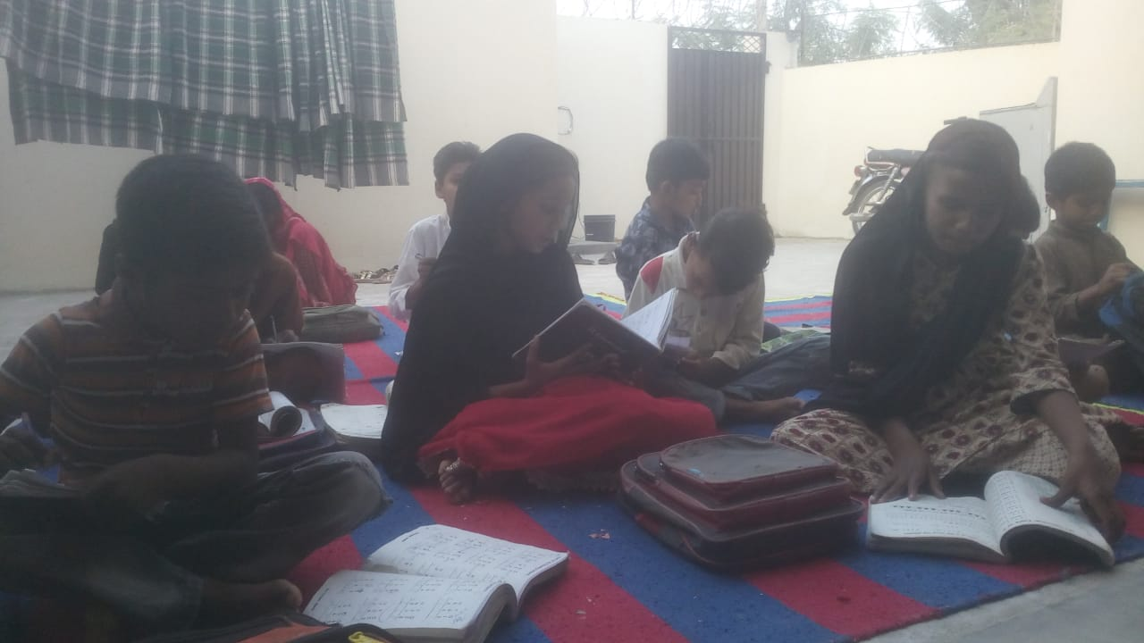
Education ratio
When we talked about Children’s parents they are not educated. Only ten percent are educated. 90 % people are under matric
Though they are very poor but rich in faith.

Slide 7
Hobbies and Health facilities
. Cricket, football,
Health facilities are not up to the mark.

Slide 8
Catechist Newly Built House

Slide 9
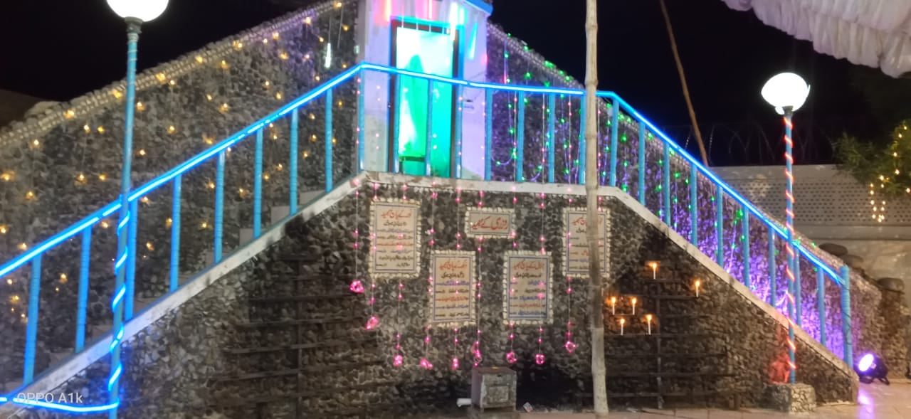
Zariat MAQDSA MARIAM(Oct12-13 2019 Saturday and Sunday.
Themes (12 Saturday)
Blessed Virgin Mary and family life with sacrament of baptism and marriage. preacher Rev. Fr. Rizwan Imtiaz OMI

Slide 10
Zariat MAQDSA MARIAM(Oct12-13 2019 Saturday and Sunday.
Themes 13 Sunday
Blessed Virgin Mary
With Sacrament of confession and healing.
Preacher Rev. Fr. Jamshed Albert OP Director of pastoral institute of Mulatn

Slide 11
Zariat MAQDSA MARIAM(Oct12-13 2019 Saturday and Sunday.

Slide 12
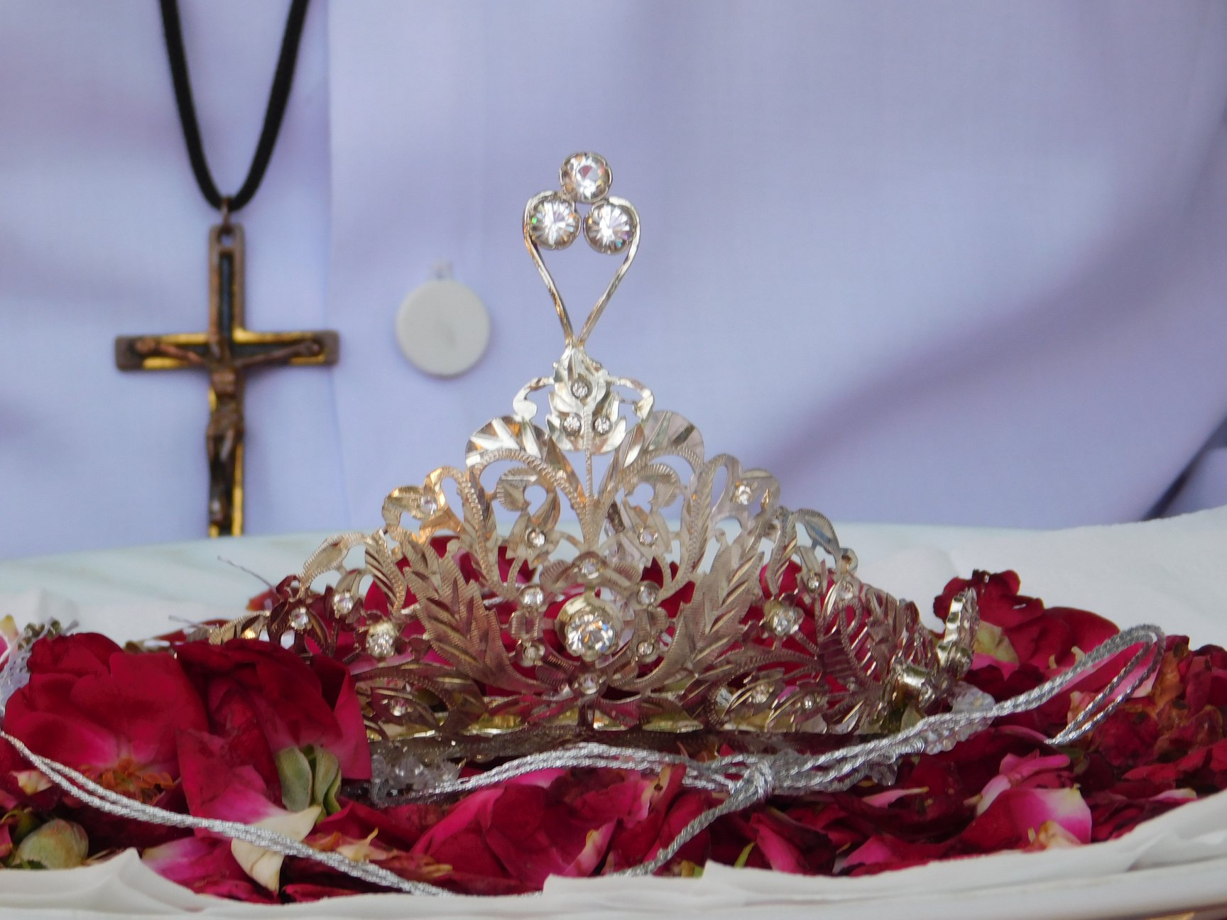
TAJPoshi Oct (12-13) 2019

Slide 13
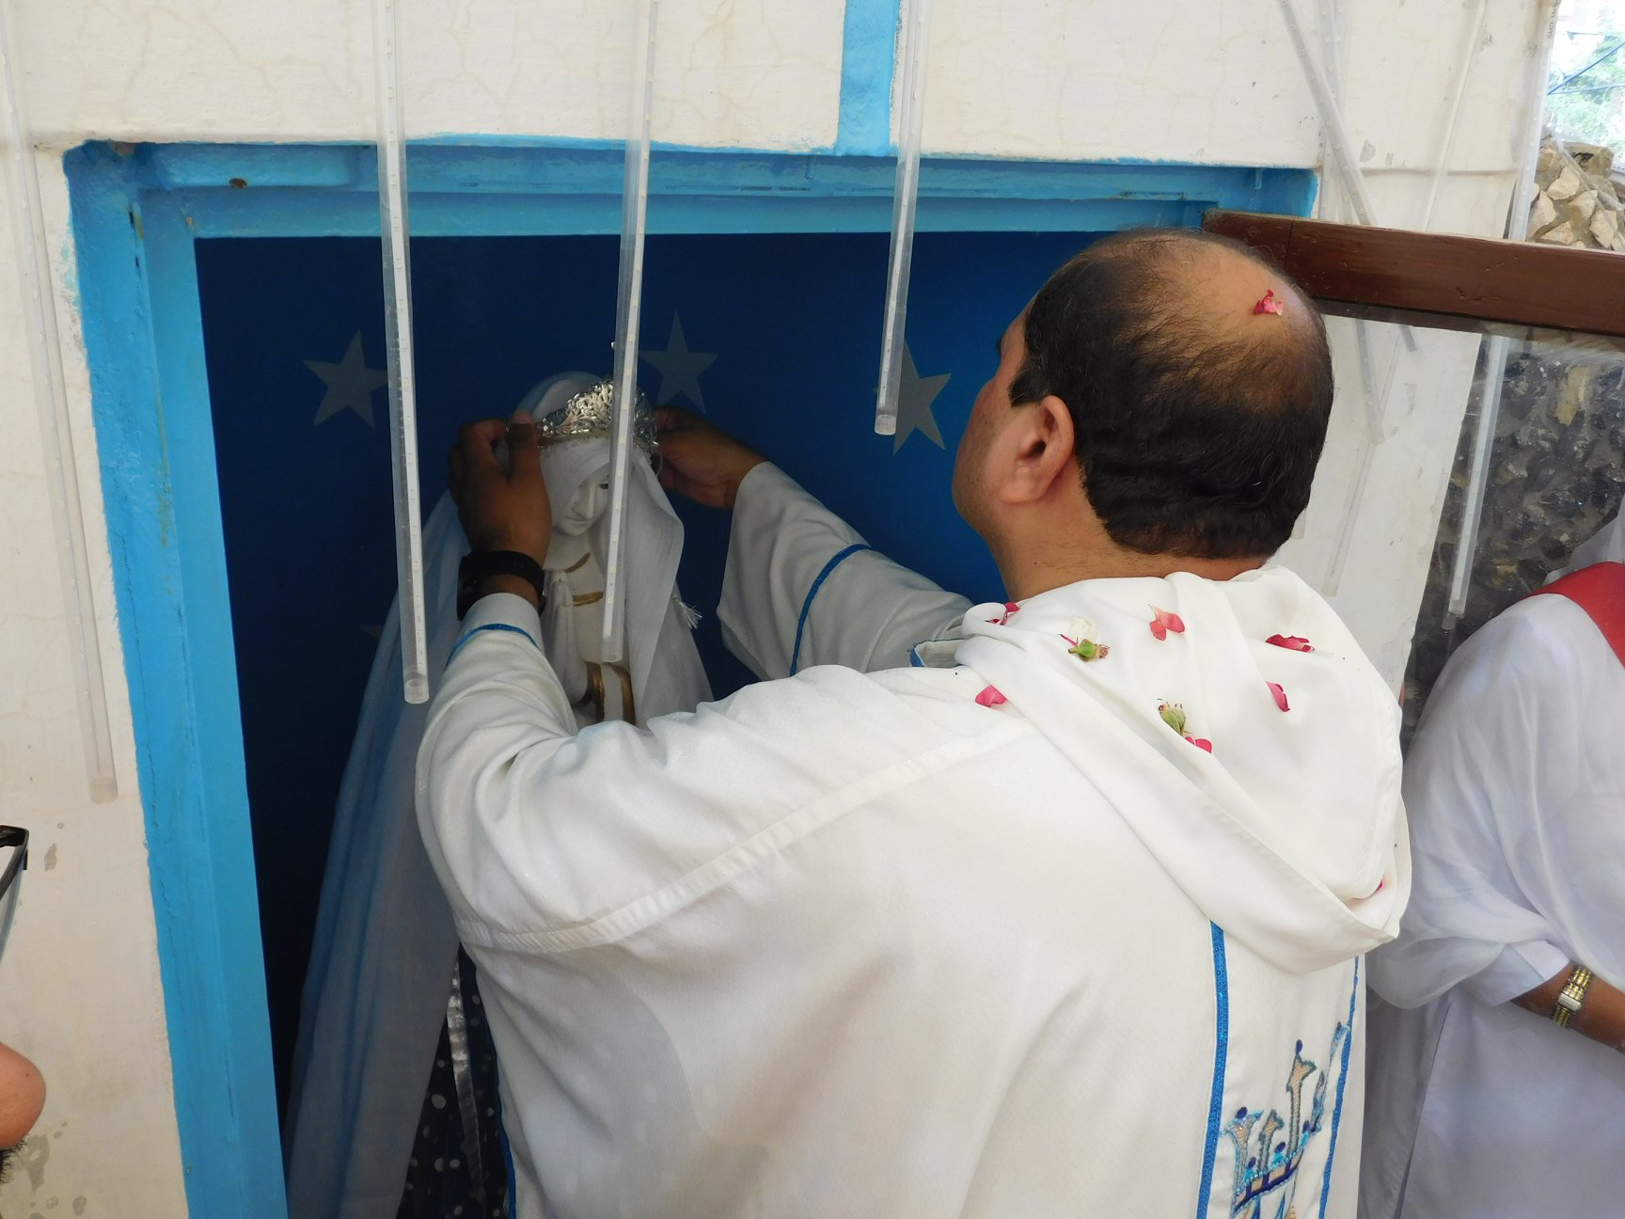
TAJPoshi Oct (12-13) 2019

Slide 14
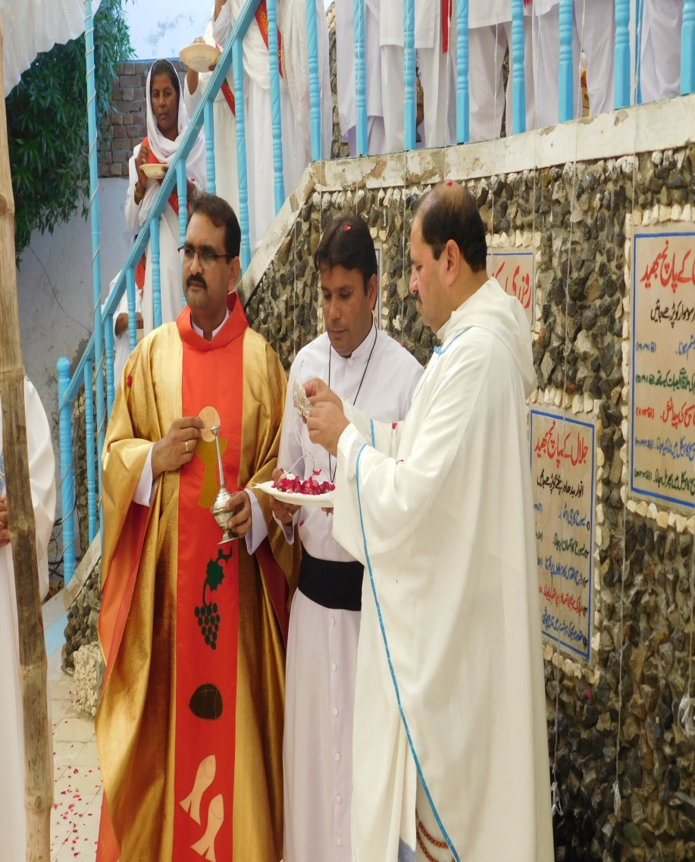
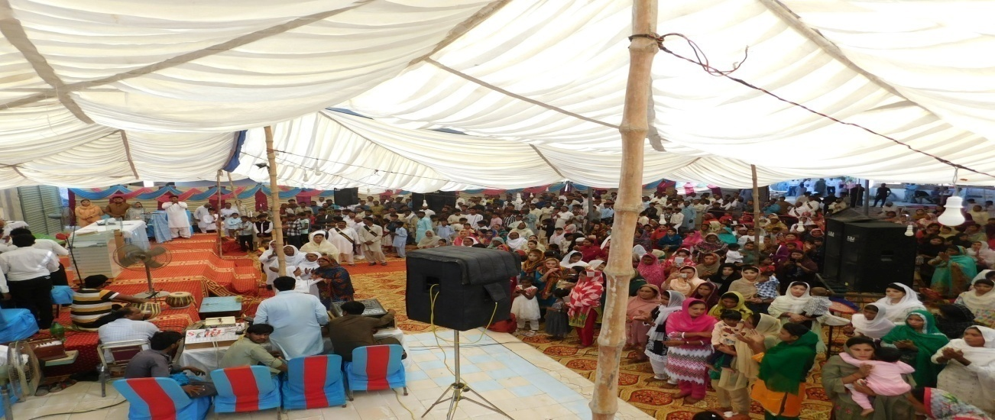
TAJ Poshi 2019

Slide 15
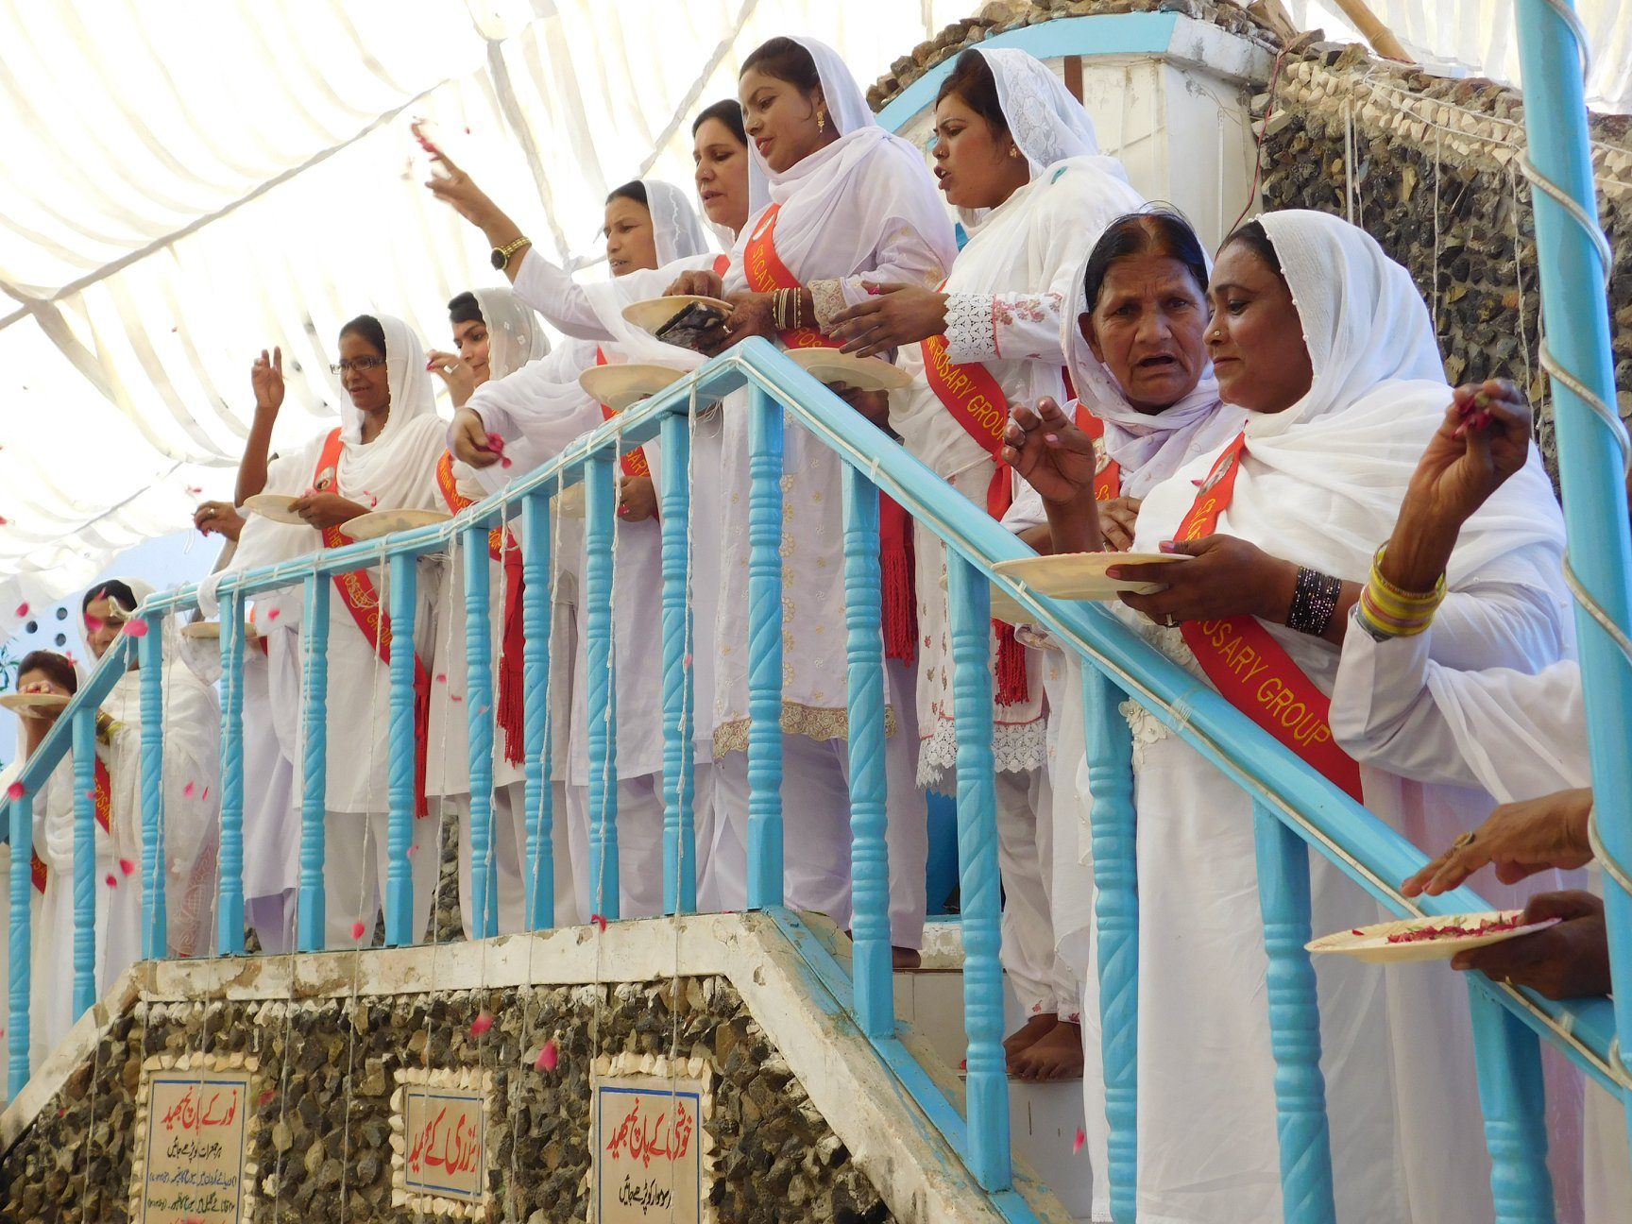
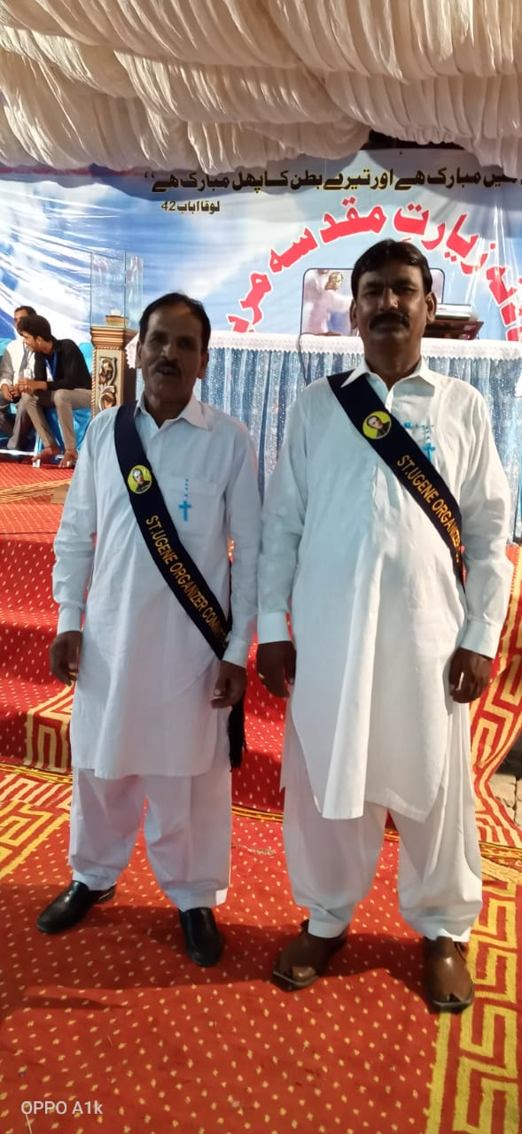
Some Picturs

Slide 16
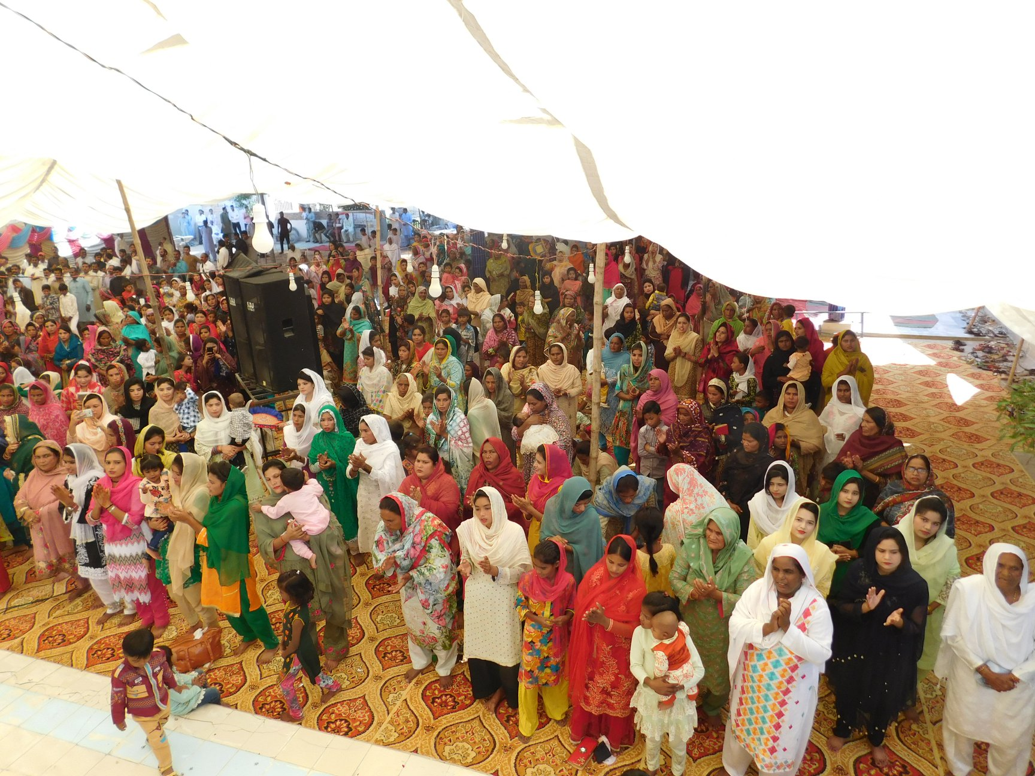
Healing service
Healing service
Rev. Fr. Maqsood Nazir OMI, Fr Waqas Raza OMI.
Catechists.
Choir group

Slide 17
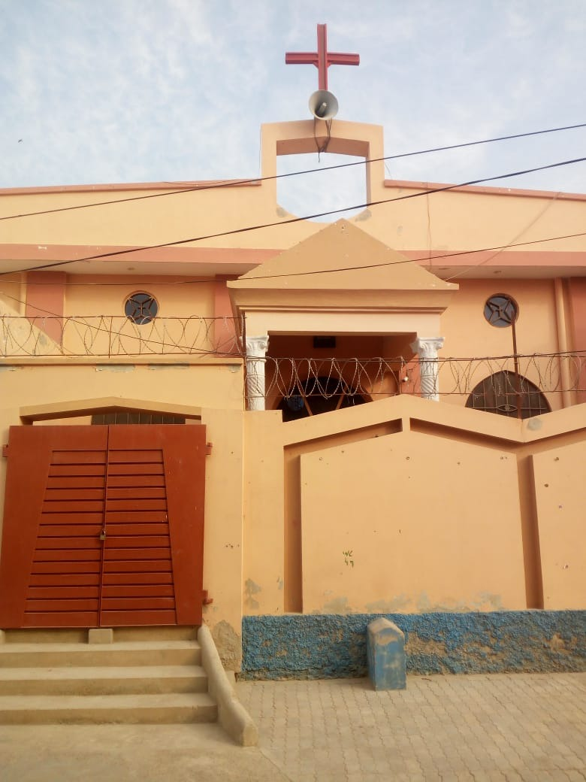
Second substations Chistian (St Mary’s Catholic church
.
Catechist Babu Sadiq is serving
32 kilometer distance
Families 134.
Christian colony 66
Yousaf town 44
15 Gajyani 16
Rest of the families are scattered around about.

Slide 18
Education Ratio
.
Here 80 percent children are getting education. Some are in good schools and some are in government schools. 60 percent are getting in good schools and rest of the children are in government schools.

Slide 19
New built House for the catechsit
.
Before this he was living on rent. It was very difficult for him to live.

Slide 20
Third substation (Dahranwala) St John Joseph catholic Church
.
catechist Master Daniel is serving.
Distance
Kilometer 48
Families 40
Dahranwala 10 families.
33/3R Families 4
35/3R Families 6
Rest of the families are also scattered.
Though they are very financially poor but rich in faith.

Slide 21
Third substation (Dahranwala)
education ration
60 % education
40 % are not getting education
Some are getting education in good schools.
Rest of the children are getting in government schools.
Work
Cultivation

Slide 22
Fourth Substation Haroonabad
Catechist Naveed Moras
Education Ratio
Catechist is serving there.
Kilometer 90
Dongabonga( 20).
Behawalnager( 40)
Total Families 65
Haroonabad 25
Behawalnager 30
Rest of the families are also but scattered.
Approximately 40-45.
Rest of the children are not getting education because of poverty.
Work
Sweeping( MC)
New catechist house is about to build.

Slide 23
Fifth Substation Fortabas
Catechist Rimzan Masih
Serving
Kilometer (90) Distance
Total families 74
Fort Abas 25
Fiqeerwali 15
Mirot 4
310/HR 4
Scattered
Work
(MC) Sweeping (80)
Others .

Slide 24
Education ratio
20-25 percent
Only two percent are graduated but of the rest under metric
Fiqeerwali 40-45
110 Kilometer
Work
Sweeping 80
20
Faith

